Slide 1

DEVICE FAILURE PREDICTION USING MULTI LAYER PERCEPTRON
Department of Artificial Intelligence & Machine Learning
AI19541 – FUNDAMENTALS OF DEEP LEARNING
221501166 - VENKAT CHIDAMBARAM . T
221501171 - VIJAYA VENKATESH .S
Mentor: AKSHAYA

Slide 2
CONTENTS
PROBLEM STATEMENT
MOTIVATION
OBJECTIVES
ABSTRACT
PROBLEM ANALYSIS
EXISTING SYSTEM
SCOPE AND LIMITATIONS
LITERATURE SURVEY
PROPOSED SYSTEM AND ITS METHODOLOGY
ARCHITECTURE DIAGRAM
LIST OF MODULES
MODULE DESCRIPTION
OUTPUT AND SCREENSHOT
COMPARATIVE ANALYSIS
CONCLUSION
REFERENCES

Slide 3
ZEROTH REVIEW

Slide 4
PROBLEM STATEMENT
Equipment failures lead to high repair costs and productivity losses.
Lack of early warning systems for potential equipment failures.
Inefficiency of traditional maintenance methods in preventing unexpected breakdowns.
Need for accurate prediction of failures using real-time sensor data.
Goal to minimize operational costs and maximize equipment life.

Slide 5
MOTIVATION
Reduce maintenance costs by predicting failures.
Minimize unexpected equipment downtime.
Improve industrial safety and productivity.
Extend equipment life span through proactive maintenance.
Enable data-driven decision-making for asset management.

Slide 6
OBJECTIVES
Design a predictive model using MLP for sensor data analysis.
Accurately predict potential equipment failures.
Identify data patterns linked to equipment breakdowns.
Improve maintenance planning and execution.
Validate model accuracy with real-world sensor data.

Slide 7
ABSTRACT
Predictive maintenance leverages sensor data and machine learning to anticipate equipment failures before they occur. This project uses a Multilayer Perceptron (MLP) model to process historical and real-time sensor data, identifying patterns that precede malfunctions. By enabling early intervention, this approach aims to reduce downtime, extend equipment lifespan, and improve industrial safety and efficiency.

Slide 8
FIRST REVIEW

Slide 9
PROBLEM ANALYSIS
High volume and complexity of sensor data.
Need for precise pattern recognition to prevent false alerts.
Real-time processing challenges with large datasets.
Limited interpretability of MLP model outputs.
Variability in sensor data quality and equipment behavior

Slide 10
EXISTING SYSTEM
Integrating Long Short-Term Memory (LSTM) networks into predictive maintenance (PdM) systems enhances the detection of time-dependent patterns in equipment behavior, allowing for the identification of gradual shifts like temperature increases or vibration anomalies. LSTMs effectively manage noisy and irregular data, making them reliable in real-world environments. This capability leads to tailored, proactive maintenance strategies, reducing downtime and lowering overall maintenance costs.

Slide 11
SCOPE AND LIMITATIONS
Scope:
Focus on predictive maintenance for industrial equipment.
Application of MLP for predictive modeling.
Limitations:
High Initial Costs
Complex Data Integration
Data Quality Issues
High Model Complexity and Maintenance
Limited Interpretability
Dependence on Real-Time Connectivity
Cybersecurity Risks

Slide 12
SECOND REVIEW

Slide 13
LITERATURE REVIEW
Paper Title | Author & year | Methodology | Inference | Limitations
"Predictive Maintenance of Wind Turbines Using Deep Learning" | Smith et al., 2020 | Deep Learning (CNN-LSTM) | Effective in detecting anomalies in wind turbines | High computational cost and large dataset requirements
"Condition Monitoring Using Random Forests in Industrial Motors" | Zhang & Lee, 2019 | Random Forest Classifier | Achieved high accuracy in predicting motor failures | Limited interpretability of model results
"A Hybrid Model for Predictive Maintenance Using SVM and Time Series Analysis" | Chen & Liu, 2018 | Support Vector Machine (SVM) combined with time series analysis | Improved fault detection accuracy by combining SVM with time series | Sensitive to data noise and requires extensive preprocessing
"Predictive Maintenance of HVAC Systems Using Gradient Boosting Machines" | Patel et al., 2021 | Gradient Boosting Machines | High accuracy in predicting failures in HVAC systems | Requires feature engineering, which is time-consuming
"Using K-Nearest Neighbors for Predictive Maintenance of Manufacturing Equipment" | Ahmed & Singh, 2020 | K-Nearest Neighbors (KNN) | Effective for small datasets, with relatively fast predictions | Effective for small datasets, with relatively fast predictions

Slide 14
LITERATURE REVIEW
Paper Title | Author & year | Methodology | Inference | Limitations
"Recurrent Neural Networks for Predictive Maintenance in Oil and Gas Pipelines" | Wang et al., 2021 | Recurrent Neural Network (RNN) | Accurate detection of faults in sequential data | Susceptible to overfitting and computationally expensive
"Bayesian Networks for Predictive Maintenance of Railway Tracks" | Gupta & Rao, 2019 | Bayesian Networks | Probabilistic model captures uncertainty in predictive maintenance | Complexity in model training and requires prior domain knowledge
"Data-Driven Predictive Maintenance Using Naive Bayes Classifier" | Adams & Li, 2022 | Naive Bayes Classifier | Simple, fast, and effective for small to moderate-sized datasets | Assumes feature independence, which may not hold in all cases
"Fault Prediction in Automotive Engines Using Ensemble Learning" | Kumar et al., 2018 | Ensemble Learning (Bagging and Boosting) | Improved fault prediction accuracy through ensemble approach | Computationally intensive and risk of overfitting
"Predicting Machine Failures in Manufacturing Using Decision Trees" | Johnson & Lee, 2020 | Decision Trees | High interpretability and ease of implementation | Limited scalability and prone to overfitting

Slide 15
SUMMARY
Diverse ML Techniques for Predictive Maintenance: Various ML models, like CNN-LSTM, Random Forest, SVM, and Decision Trees, are used for predictive maintenance, each offering distinct advantages depending on the application.
Effectiveness and Applicability: Many models show high accuracy in specific industries, such as wind turbines, HVAC systems, and manufacturing, making them effective in targeted settings.
Computational Complexity and Data Requirements: Deep learning models are powerful but require large datasets and high computational power, whereas simpler models are easier to implement but may struggle with complex data.
Trade-offs in Model Interpretability: Simpler models like Decision Trees are easy to interpret, while complex models like RNN and Bayesian Networks capture more detail but are harder to understand.
Challenges in Generalization and Scalability: Issues include overfitting, high costs, and data sensitivity, requiring careful algorithm selection to balance performance and scalability across applications.

Slide 16
PROPOSED SYSTEM AND ITS METHODOLOGY
Proposed System:
Predictive Model: Use a Multilayer Perceptron (MLP) to analyze sensor data for predicting equipment failures.
Real-Time Monitoring: Enable continuous monitoring of equipment by integrating the MLP model with live sensor feeds.
Alert System: Generate early warning alerts for potential equipment malfunctions to allow proactive maintenance.
Methodology:
Data Collection: Gather historical and real-time sensor data relevant to equipment performance.
Data Preprocessing: Clean and normalize data, handling missing values and scaling features as needed.
Model Training: Train the MLP model using labeled failure data to recognize patterns indicative of potential faults.
Evaluation: Validate model performance using metrics such as accuracy, precision, and recall.
Deployment: Deploy the trained model in a production environment to monitor equipment and provide predictive alerts.

Slide 17
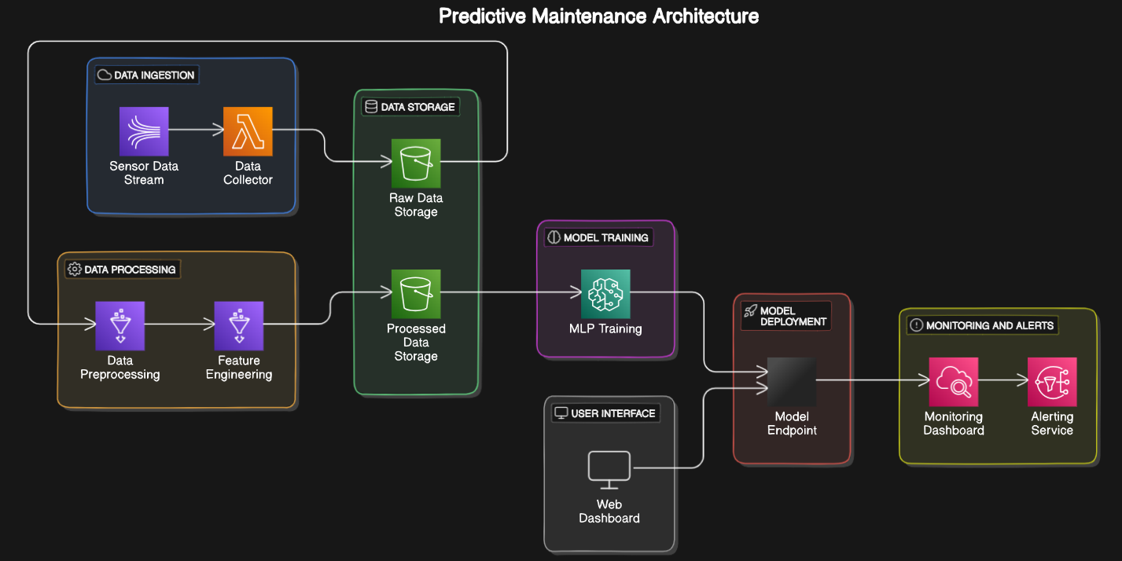
ARCHITECTURE DIAGRAM

Slide 18
THIRD REVIEW

Slide 19
LIST OF MODULES
Data Collection Module
Data Preprocessing Module
Feature Engineering Module
MLP Model Training Module
Model Evaluation Module
Real-Time Inference Module
Alert and Notification Module
Dashboard and Visualization Module
Feedback and Model Update Module
Data Storage and Management Module

Slide 20
MODULE DESCRIPTION
–>Data Collection Module
Collects real-time data from various sensors (e.g., temperature, vibration, pressure).
–>Data Preprocessing Module
Cleans and preprocesses data, handling missing values, reducing noise, and normalizing inputs for model readiness.
–>Feature Engineering Module
Extracts key features from sensor data that highlight important patterns or signals related to equipment health.

Slide 21
MODULE DESCRIPTION
–>MLP Model Training Module
Trains the Multi-Layer Perceptron (MLP) model on historical data to learn patterns associated with equipment failures.
–>Model Evaluation Module
Assesses model performance with metrics like accuracy, precision, recall, and F1-score to ensure reliability.
–>Real-Time Inference Module
Applies the trained MLP model to live data for real-time failure predictions.

Slide 22
FINAL REVIEW

Slide 23
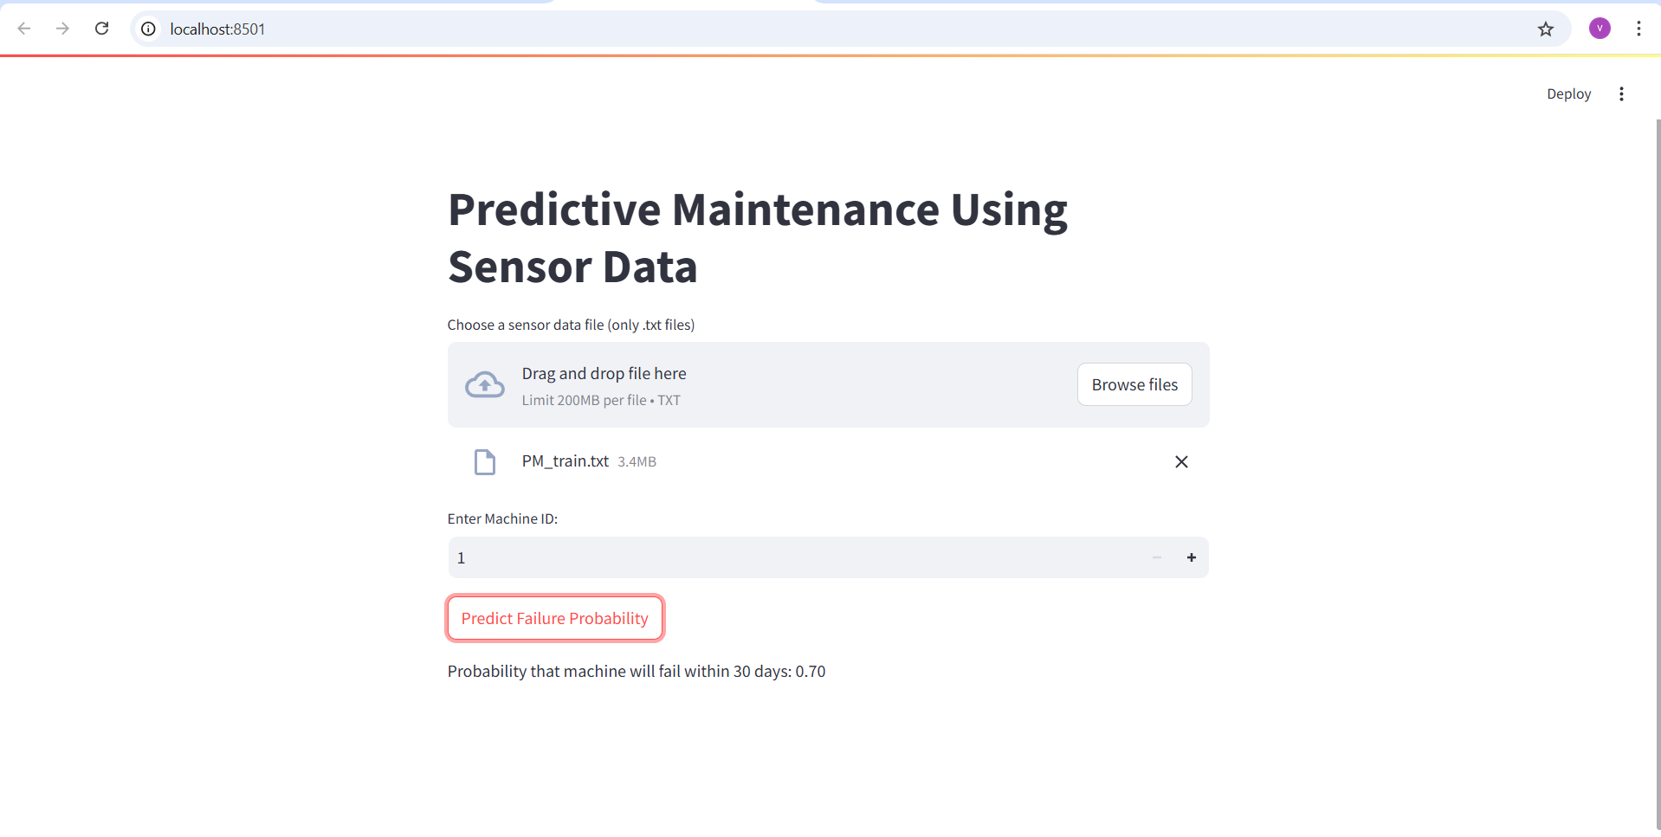
OUTPUT AND SCREENSHOTS

Slide 24
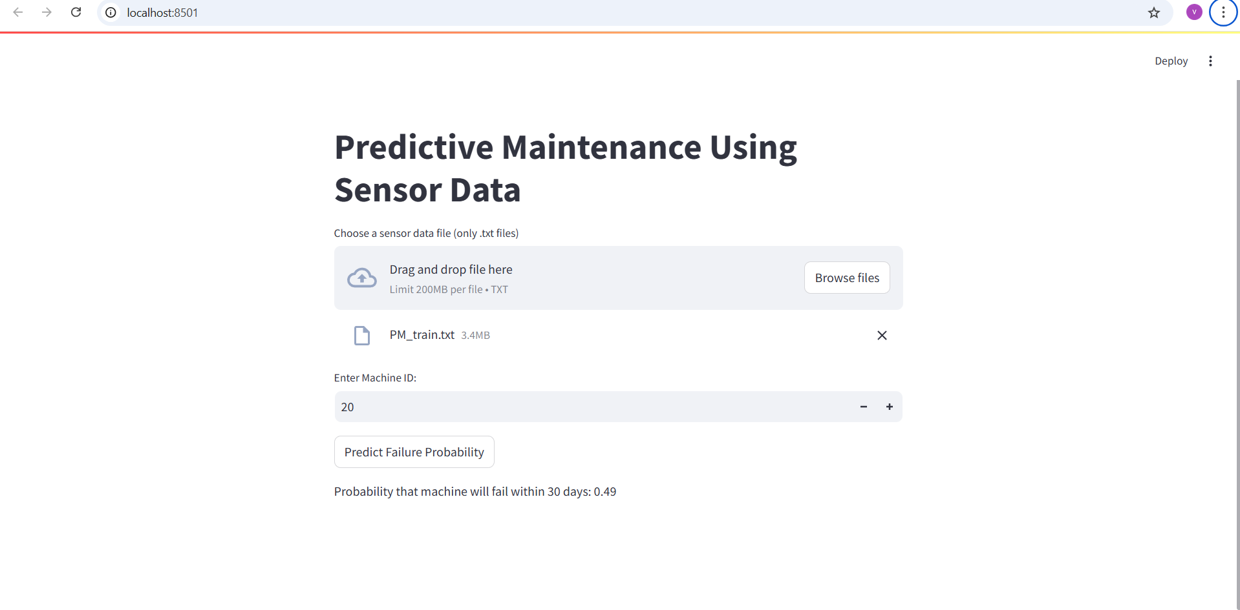
OUTPUT AND SCREENSHOTS

Slide 25
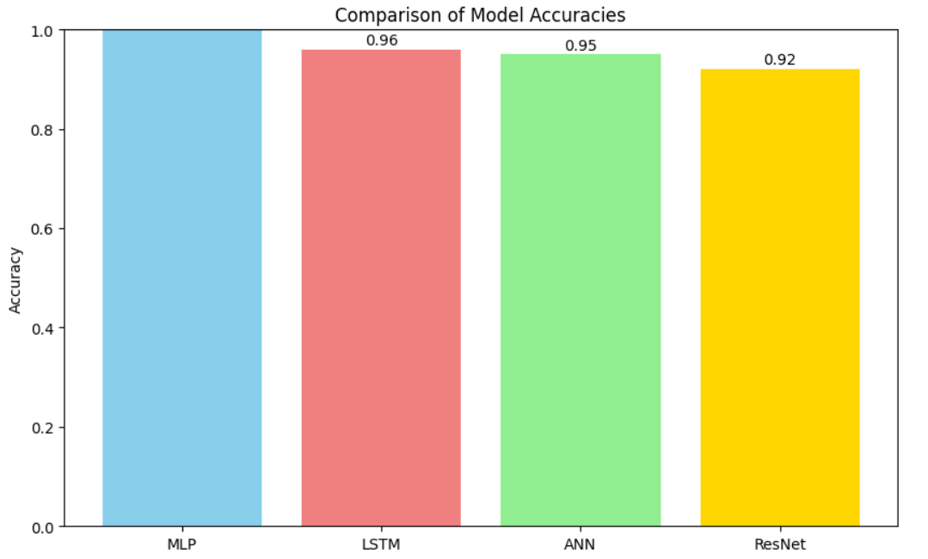
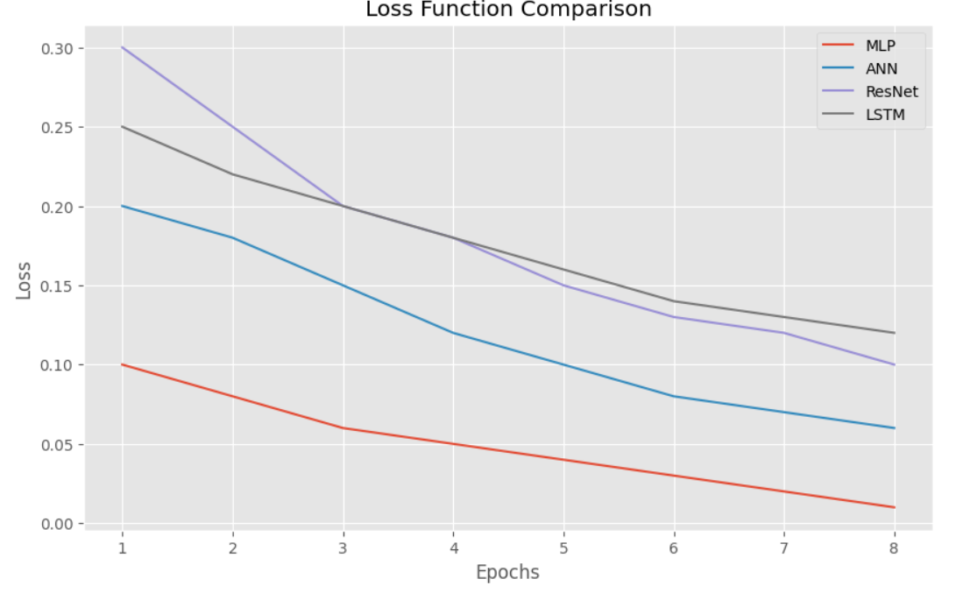
COMPARATIVE ANALYSIS

Slide 26
CONCLUSION
In conclusion, implementing a predictive maintenance (PdM) system using a Multi-Layer Perceptron (MLP) model provides a robust and efficient approach to equipment maintenance. By leveraging sensor data and machine learning, this system enables the early detection of potential failures, allowing maintenance to be scheduled proactively. The comprehensive modules—from data collection and preprocessing to real-time inference and feedback—work together to ensure accurate predictions, minimize downtime, and extend asset lifespan. Overall, this MLP-based PdM solution not only optimizes maintenance schedules but also reduces operational costs, enhances equipment reliability, and contributes to a more efficient and resilient maintenance strategy.

Slide 27
REFERENCES
R. Yan, R. X. Gao, and X. Chen. “Multi-Layer Perceptron for machine fault diagnosis and predictive maintenance.” IEEE Transactions on Industrial Informatics, 2019.
W. Zhang, Y. Yang, Y. Xiao, and T. Zhang. “A data-driven predictive maintenance model using MLP neural networks in industrial IoT environments.” Journal of Manufacturing Systems, 2020.
M. A. El-Diraby and Y. Zhu. “Predictive maintenance for asset management in industrial environments.” Journal of Computational Civil Engineering, 2021.
P. Kumar and B. W. Lim. “A review on predictive maintenance techniques for industrial equipment using machine learning.” Sensors, 2022.
S. Hochreiter and J. Schmidhuber. “Long Short-Term Memory.” Neural Computation, 1997 – foundational LSTM research relevant to time-series analysis in PdM.

Slide 28
REFERENCES
S. Wang, Y. Liu, and H. Yu. “A predictive maintenance approach using deep learning for equipment monitoring.” Computers in Industry, 2018.
M. Hu, J. Ding, and R. Zhang. “Application of multi-layer neural networks in predictive maintenance for equipment in smart factories.” IEEE Access, 2019.
V. H. Nguyen, C. S. Yang, and P. P. Ramachandran. “Real-time data processing and predictive maintenance using machine learning.” International Journal of Prognostics and Health Management, 2021.
B. Zhou, H. Xu, and Y. Chen. “Development of a cloud-based predictive maintenance system using IoT and AI technologies.” Procedia CIRP, 2019.
A. J. Smola and B. Schölkopf. “A tutorial on support vector regression.” Statistics and Computing, 2004 – for foundational machine learning methods that influence model selection in PdM.

